Slide 1

FSDJ-II ID201B Even Semester Session 2024-25
Fit Flow
Tanya Singh 202410116100222
Subhash Kumar 202410116100211
Project Supervisor:
Dr. Divya Singhal

Slide 2
INDEX
1. Introduction
2. Literature Review
3. Objective of the Project
4. Technology
- Hardware Requirements
- Software Requirements
5. Modules
6. Workflow
7. Reports
8. References

Slide 3

Fit Flow: Revolutionizing Gym Management
Meet Fit Flow, a Java-powered gym management app that’s all about making things easier for you and your members. It’s got everything you need to keep your gym running smoothly, from managing memberships to scheduling classes and handling billing. Plus, it’s packed with useful reports to help you track your progress and make data-driven decisions. Whether you’re a gym owner, manager, or just a fitness enthusiast, Fit Flow is the perfect tool for you.

Slide 4
Literature Review: The Need for Integrated Gym Management
Existing Solutions & Limitations
Market Analysis:
Competitors
This section reviews existing gym management solutions, identifying their limitations. We’ll explore their functionalities, user experiences, and drawbacks, such as lacking comprehensive features or user-friendly interfaces.
We'll conduct a thorough analysis of competitors in the gym management software market, including Mindbody, This will help us understand their strengths, weaknesses, and target market.
Database Technologies
Java's Capabilities
Database technologies MySQL and PostgreSQL will be evaluated.
Java is a powerful language for building efficient and secure gym management software.

Slide 5

Objective of Fit Flow:
A Smarter Gym
1
Fit Flow aims to streamline gym operations and improve efficiency.
2
We aim to increase member retention by 20%, reduce administrative overhead by 30%, and improve overall gym efficiency.
3
We'll set SMART goals for the project, focusing on achieving a 99.9% system uptime within the first year of deployment.
4
Key performance indicators (KPIs) will track member satisfaction, revenue growth, and operational cost reduction.

Slide 6

Technology: Powering Fit Flow
Java
Java is chosen for its portability, scalability, and security, ensuring a robust and reliable application.
Frameworks
Spring Boot will handle the backend development, JavaFX will provide the user-friendly interface, and Android SDK will be used for a mobile app.
IDE
We'll use VS Code, IntelliJ IDEA, or Eclipse for development, debugging, and testing.
Database
MySQL or PostgreSQL will store all the essential gym data.

Slide 7


Requirements: Building the Foundation
Hardware Requirements
Minimum Hardware Requirements: Standard laptop with 16GB+ RAM and 512GB SSD+.
Server Options: Cloud-based server (AWS, Azure, Google Cloud) or on-premise server with appropriate specifications.
Software Requirements
Programming Language: Java
Frameworks/Libraries: Spring Boot, JDK
Database: MySQL or PostgreSQL
IDE: VS Code/IntelliJ IDEA with Java plugins

Slide 8




Key Modules of FitFlow
Membership Management
Scheduling & Booking
Reporting & Analytics
Features include member registration, profile management, attendance tracking, membership renewal, and automated billing.
Fit Flow will offer class scheduling, trainer booking, resource allocation, an online booking portal, and automated reminders.
Features include customizable reports, data visualization, trend analysis, and revenue forecasting.

Slide 9
Fit Flow Workflow: From Sign-Up to Success
Member Sign-Up
1
Members can sign up online or offline, providing their information for data input.
Schedule Creation & Assignment
2
Billing Cycle & Payment
Gym staff create class schedules, assign trainers, and allocate resources.
3
Fit Flow automates billing cycles and processes payments.
Performance Tracking & Data Analysis
4
The system tracks key metrics and provides data-driven insights.
Reporting & Optimization
5
Fit Flow generates customizable reports, enabling gym owners to make informed decisions.

Slide 10
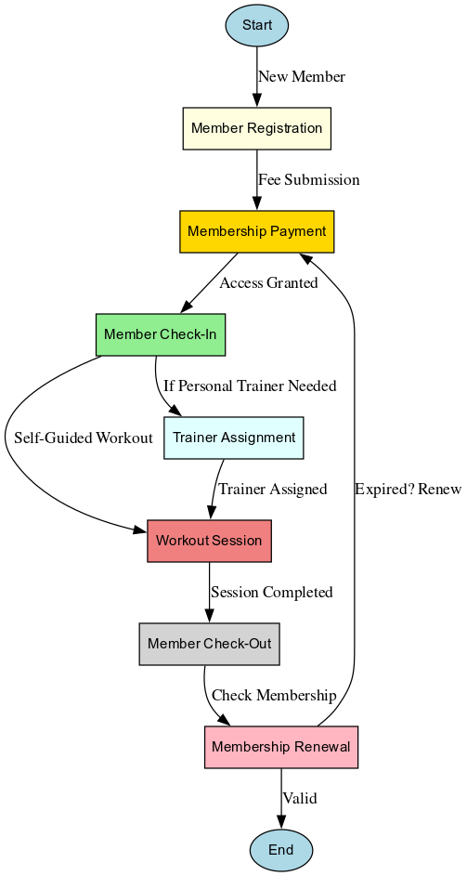
Workflow

Slide 11



Reports and
Future Work
Reports
Future Work
Regular progress reports will be generated, summarizing completed tasks, challenges faced, and planned activities.
Implement AI-driven workout recommendations and mobile app integration for enhanced user experience.

Slide 12
Referencs
https://docs.oracle.com/en/java/
https://docs.spring.io/spring-boot/docs/current/reference/html/
https://dev.mysql.com/doc/
https://www.postgresql.org/docs/
https://hibernate.org/orm/documentation/
https://openjfx.io/
https://commons.apache.org/

